Slide 1
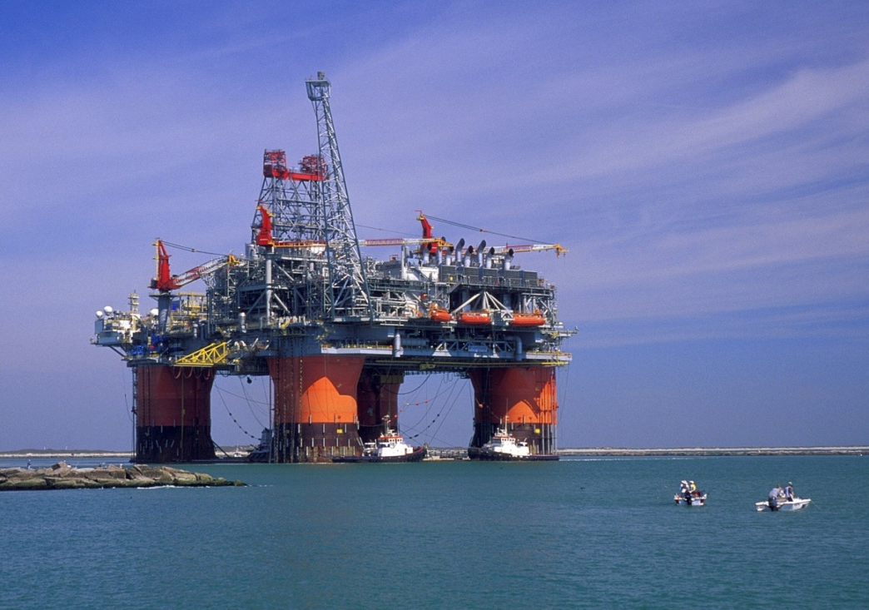
The Lebanese Hydrocarbon Sector
Abboud Zahr
Managing Director
DEP Levant Oil & Gas

Slide 2
HSE Consultancy
Technical Feasibility Studies
Engineering: Tanks, Pipelines, LNG Plant
Logistics
Inspection, Quality Assurance

Slide 3
DEP Lebanon

Slide 4
Lebanese Offshore Petroleum Resources Law No. 132 September 2010
Production Sharing Agreement
Consortium of min. 3 companies, at least one of them as operator.
Exploration period: Max.10 years
Production period: Max. 30 years
Award subject to the approval of the Council of Ministers
Environmental Regulations
Proceeds will be put in a sovereign fund

Slide 6
Two Pending Decrees by the Lebanese Government
Offshore Blocks Division (10 Blocks).
Production Sharing Agreement:
Period of exploration and production.
The percentage of the Lebanese Government from the production.
HSE Rules

Slide 7
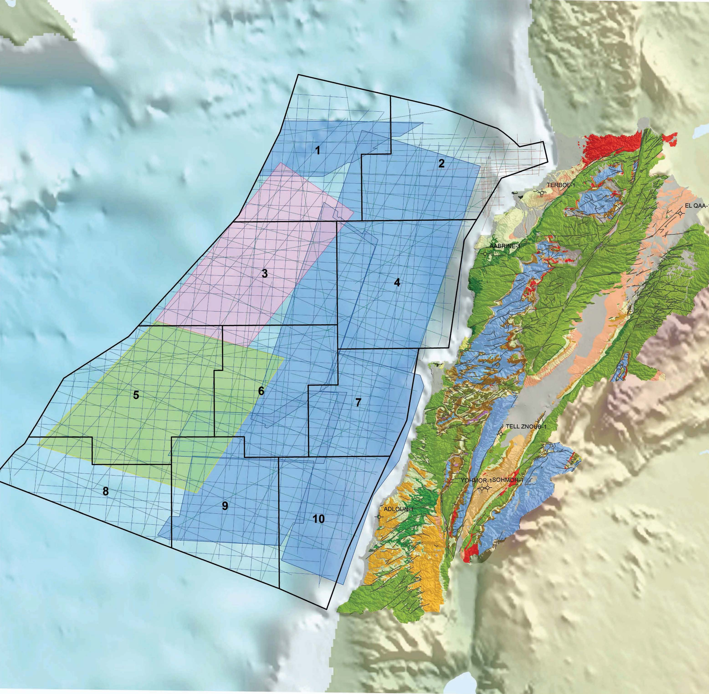

Slide 8
Advantages given to Lebanese Goods, Services and Employees
The Exploration and Production Agreement between the Lebanese Government and the Right Holders (Consortium) stipulates the following:
Training of Lebanese Nationals
80% of the right holders personnel and their sub-contractors shall be Lebanese
10% price advantage on services
5% price advantages on goods

Slide 9
Lebanon Economical Problems
Low Growth rates
Budget deficit
High emigration rate
Low job opportunities for new graduates
High unemployment rate
High debts: 68 Billions USD

Slide 10
Advantages of the new Oil & Gas Industry
Jobs Creation
High income from hydrocarbon sales
Cheap energy/electricity
Appreciation of the Lebanese rating by the international financial institutions
Appreciation of the debt solvency
Know-how transfer from the oil companies to the Lebanese
Export acquired services and knowledge to other countries

Slide 11
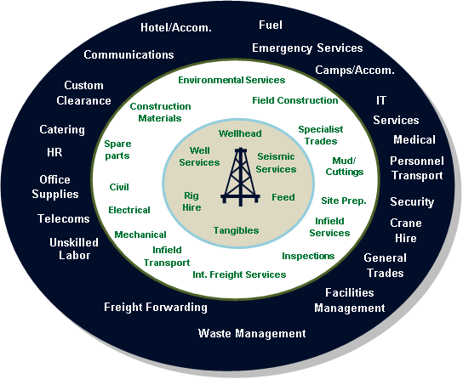
Potential Services

Slide 12
Delay in Awarding the Offshore Blocks
Negative Implications:
Crash in oil price: 50% lower
Oil Companies Reduced Exploration Budget
Oil Companies lost their interest in Lebanon
Export Markets Lost

Slide 13
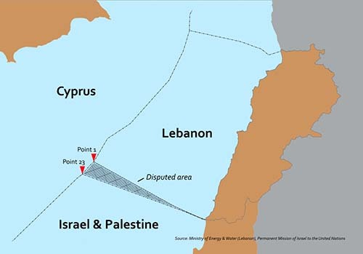
Lebanese – Israeli Maritime Boarder

Slide 14
www.lebanongasnews.com

Slide 15
Thank you
Abboud Zahr
DEP Levant Oil & Gas
Cyprus

